Slide 1
SOTON-WAIS @ SED2013
Sparse Features and incremental density based clustering
Sina Samangooei

Slide 3
Build Sparse Matrix

Slide 4
Build Sparse Matrix
Cluster

Slide 5
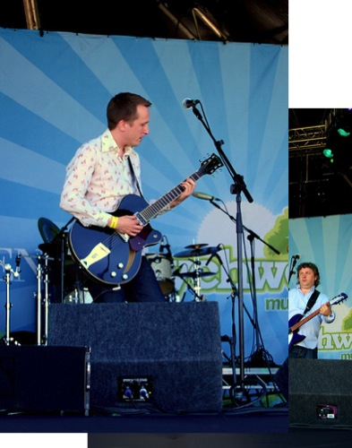
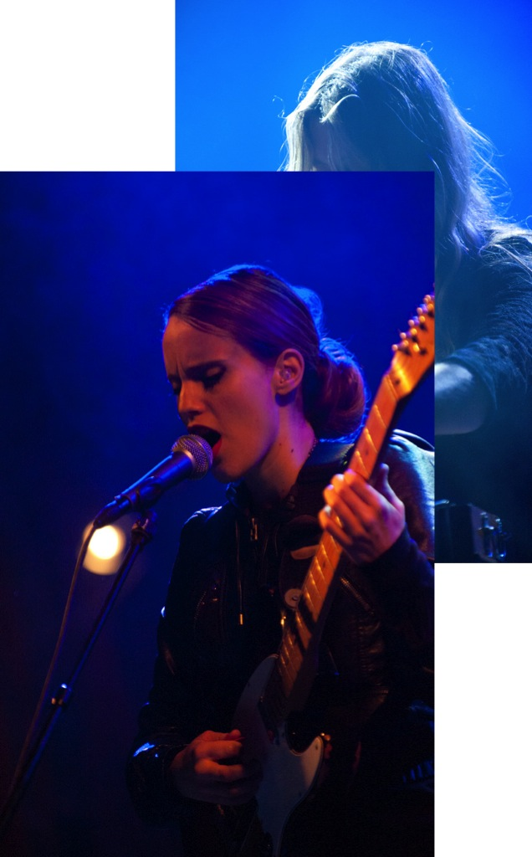
Build Sparse Matrix
Cluster

Slide 6
Main Achievements
CreatE big sparse similarity matrices
(quickly)
Open source
Clustering, Experiments… the lot
…OpenIMAJ… woo!
incremental clustering
Spectral clustering with 300k items, 0.01 density.
Hard to do naively, try in matlab or python:
eigsh(srand(300000,300000,0.001),1000)
Assuming you have 128Gb RAM It’ll be done soon(ish)

